Slide 1
CS:APP Chapter 4
Computer Architecture
Pipelined
Implementation
Randal E. Bryant
adapted by Jason Fritts
http://csapp.cs.cmu.edu
CS:APP2e

Slide 2
Overview
General Principles of Pipelining
  Goal
  Difficulties
Creating a Pipelined Y86 Processor
  Rearranging SEQ to create pipelined datapath, PIPE
  Inserting pipeline registers
  Problems with data and control hazards

Slide 3
Fundamentals of
Pipelining

Slide 4


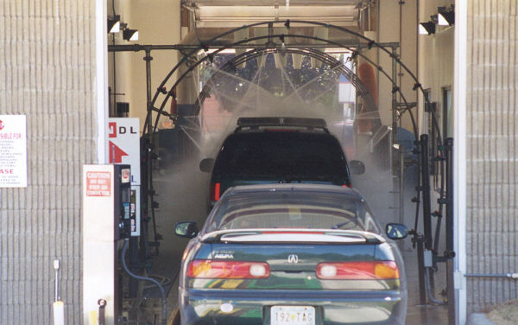
Real-World Pipelines: Car Washes
Sequential
Parallel
Pipelined
Idea
  Divide process into independent stages
  Move objects through stages in sequence
  At any given times, multiple objects being processed

Slide 5
Computational Example
300 ps
20 ps
Combinational
logic
R
e
g
Delay = 320 ps
Throughput = 3.12 GIPS
Clock
System
  Computation requires total of 300 picoseconds
  Additional 20 picoseconds to save result in register
  Must have clock cycle of at least 320 ps

Slide 6
3-Way Pipelined Version
100 ps
20 ps
100 ps
20 ps
100 ps
20 ps
Comb.
logic
A
R
e
g
Comb.
logic
B
R
e
g
Comb.
logic
C
R
e
g
Delay = 360 ps
Throughput = 8.33 GIPS
Clock
System
  Divide combinational logic into 3 blocks of 100 ps each
  Can begin new operation as soon as previous one passes through stage A.
    Begin new operation every 120 ps
  Overall latency increases
    360 ps from start to finish

Slide 7
Pipeline Diagrams
Unpipelined
  Cannot start new operation until previous one completes
3-Way Pipelined
  Up to 3 operations in process simultaneously
OP1
OP2
OP3
Time
OP1
A
B
C
OP2
A
B
C
OP3
A
B
C
Time

Slide 8
Operating a Pipeline
239
241
300
359
Clock
OP1
A
B
C
OP2
A
B
C
OP3
A
B
C
0
120
240
360
480
640
Time
100 ps
20 ps
100 ps
20 ps
100 ps
20 ps
100 ps
100 ps
100 ps
20 ps
20 ps
20 ps
100 ps
100 ps
100 ps
20 ps
20 ps
20 ps
100 ps
100 ps
100 ps
20 ps
20 ps
20 ps
Comb.
logic
A
R
e
g
Comb.
logic
B
R
e
g
Comb.
logic
C
Comb.
logic
A
R
e
g
Comb.
logic
B
R
e
g
Comb.
logic
C
R
e
g
Comb.
logic
A
Comb.
logic
A
R
e
g
R
e
g
Comb.
logic
B
Comb.
logic
B
R
e
g
R
e
g
Comb.
logic
C
Comb.
logic
C
R
e
g
R
e
g
R
e
g
Clock
Clock
Clock
Clock

Slide 9
Limitations: Nonuniform Delays
50 ps
20 ps
150 ps
20 ps
100 ps
20 ps
Comb.
logic
A
R
e
g
Comb.
logic
B
R
e
g
Comb.
logic
C
R
e
g
Delay = 510 ps
Throughput = 5.88 GIPS
Clock
OP1
A
B
C
OP2
A
B
C
OP3
A
B
C
Time
  Throughput limited by slowest stage
  Other stages sit idle for much of the time
  Challenging to partition system into balanced stages

Slide 10
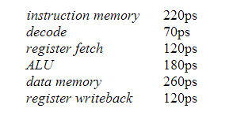
Sample Circuit Delays & Pipelining
20ps delay for hardware register at end of cycle
Single-cycle processor:
  Clock cycle = 220 + 70 + 120 + 180 + 260 + 120 + 20 = 990ps
  Clock freq = 1 / 990ps = 1 / 990*10⁻¹² = 1.01 GHz
Combine and/or split stages for pipelining
  Need to balance time per stage since clock freq determined by slowest time
  Must maintain original order of stages, so can’t combine non-neighboring stages (e.g. can’t combine decode & data mem)

Slide 11
Sample Circuit Delays & Pipelining
20ps delay added for hardware register at end of each cycle
3-stage pipeline:
  Best combination for minimizing clock cycle time:
    1st stage – instr mem & decode: 220 + 70 + 20 = 310ps
    2nd stage – reg fetch & ALU: 120 + 180 + 20 = 320ps
    3rd stage – data mem & reg WB: 260 + 120 + 20 = 400ps
  Slowest stage is 400ps, so clock cycle time is 400ps
  Clock freq = 1 / 400ps = 1 / 400*10⁻¹² = 2.5 GHz

Slide 12
Sample Circuit Delays & Pipelining
20ps delay added for hardware register at end of each cycle
5-stage pipeline:
  Best combination for minimizing clock cycle time:
    1st stage – instr mem: 220 + 20ps = 240ps
    2nd stage – decode & reg fetch: 70 + 120 + 20ps = 210ps
    3rd stage – ALU: 180 + 20ps = 200ps
    4th stage – data mem: 260 + 20ps = 280ps
    5th stage – reg WB: 120 + 20ps = 140ps
  Slowest stage is 400ps, so clock cycle time is 280ps
  Clock freq = 1 / 280ps = 1 / 280*10⁻¹² = 3.57 GHz

Slide 13
Sample Circuit Delays & Pipelining
20ps delay added for hardware register at end of each cycle
9-stage pipeline:
  Assuming can split stages evenly into halves, thirds, or quarters
    not a valid assumption, but useful for simplifying problem
  Best combination for minimizing clock cycle time:
    Each circuit is its own stage, with 20ps added delay for reg
    Split instr mem circuit into two stages, each 110+20ps
    Split data mem circuit into two stages, each 130+20ps
    Split ALU circuit into two stages, each 90+20ps
  Slowest stage is 150ps, so clock cycle time is 150ps
  Clock freq = 1 / 150ps = 1 / 150*10⁻¹² = 6.67 GHz

Slide 14
Limitations: Register Overhead
50 ps
20 ps
50 ps
20 ps
50 ps
20 ps
50 ps
20 ps
50 ps
20 ps
50 ps
20 ps
Comb.
logic
R
e
g
Comb.
logic
R
e
g
Comb.
logic
R
e
g
Comb.
logic
R
e
g
Comb.
logic
R
e
g
Comb.
logic
R
e
g
Clock
Delay = 420 ps, Throughput = 14.29 GIPS
  As try to deepen pipeline, overhead of loading registers becomes more significant
  Percentage of clock cycle spent loading register:
    1-stage pipeline: 6.25%
    3-stage pipeline: 16.67%
    6-stage pipeline: 28.57%
  High speeds of modern processor designs obtained through very deep pipelining

Slide 15
Converting SEQ to PIPE, a pipelined datapath

Slide 16
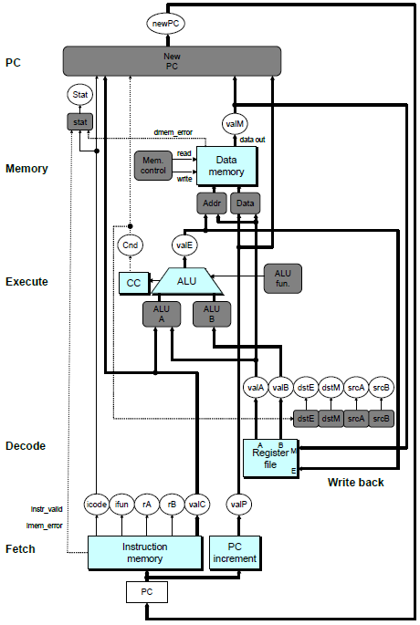
SEQ Hardware
  Stages occur in sequence
  One operation in process at a time
To convert to pipelined datapath, start by adding registers between stages, resulting in 5 pipeline stages:
  Fetch
  Decode
  Execute
  Memory
  Writeback

Slide 17
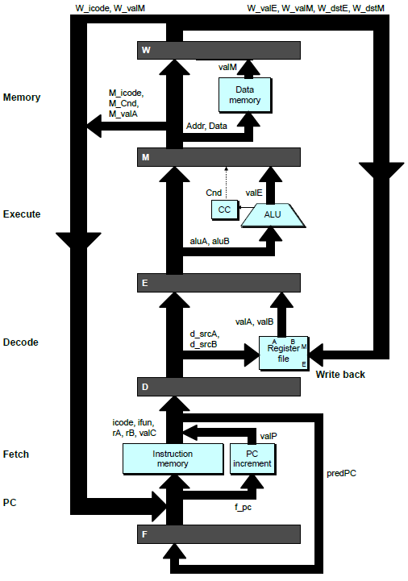
Converting to pipelined datapath
PC
newPC
Write back
valE
,
valM
valM
Data
Memory
Data
memory
memory
Addr
, Data
valE
CC
CC
ALU
Execute
Cnd
ALU
aluA
,
aluB
Add pipeline registers between stages
valA
,
valB
Decode
srcA
,
srcB
A
A
B
dstA
,
dstB
B
M
Register
M
Register
Register
Register
file
file
file
file
E
E
icode
,
ifun
valP
rA
,
rB
valC
Instruction
PC
Instruction
PC
Fetch
memory
increment
memory
increment
PC

Slide 18
Problem: Fetching a new instruction each cycle
Two problems
  PC generated in last stage of SEQ datapath
  PC sometimes not available until end of Execute or Memory stage
PC needs to be computed early
  In order to fetch a new instruction every cycle, PC generation must be moved to first stage of datapath
  Solve first problem by moving PC generation from end of SEQ to beginning of SEQ
Use prediction to select PC early
  Solve second problem by predicting next instruction from current instruction
  If prediction is wrong, squash (kill) predicted instructions

Slide 19
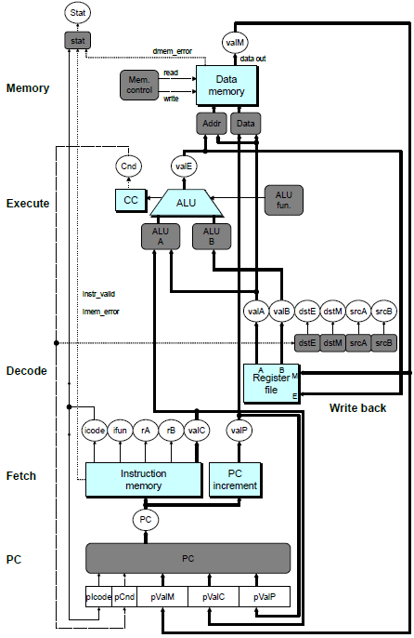
SEQ+ Hardware
  Still sequential implementation
  Reorder PC stage to put at beginning
PC Stage
  Task is to select PC for current instruction
  Based on results computed by previous instruction
Processor State
  PC is no longer stored in register
  But, can determine PC based on other stored information

Slide 20
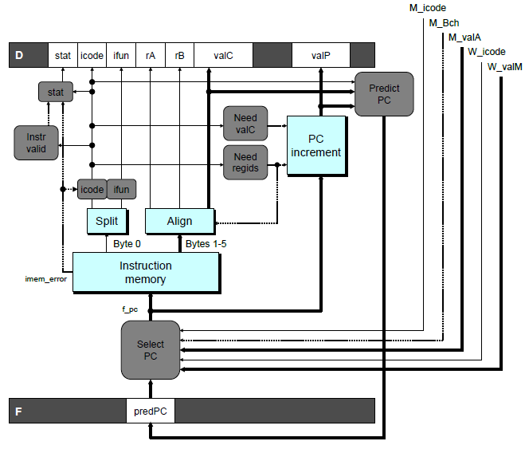
Predicting the PC
  Start fetch of new instruction after current has been fetched
    Not enough time to fully determine next instruction
  Attempt to predict which instruction will be next
    Recover if prediction was incorrect

Slide 21
Our Prediction Strategy
  Predict next instruction from current instruction
Instructions that Don’t Transfer Control
  Predict next PC to be valP
  Always reliable
Call and Unconditional Jumps
  Predict next PC to be valC (destination)
  Always reliable
Conditional Jumps
  Predict next PC to be valC (destination)
  Only correct if branch is taken
    Typically right 60% of time
Return Instruction
  Don’t predict, just stall

Slide 22
Recovering from PC Misprediction
Mispredicted Jump
  Will see branch condition flag once instruction reaches memory stage
  Can get fall-through PC from valA (value M_valA)
Return Instruction
  Will get return PC when ret reaches write-back stage (W_valM)

Slide 23
Pipeline Stages
Fetch
  Select current PC
  Read instruction
  Compute incremented PC
Decode
  Read program registers
Execute
  Operate ALU
Memory
  Read or write data memory
Write Back
  Update register file

Slide 24
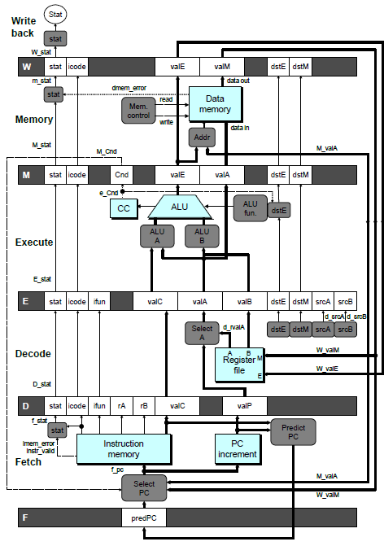
PIPE- Hardware
  Pipeline registers hold intermediate values from instruction execution
Forward (Upward) Paths
  Values passed from one stage to next
  Cannot jump past stages
    e.g., valC passes through decode

Slide 25
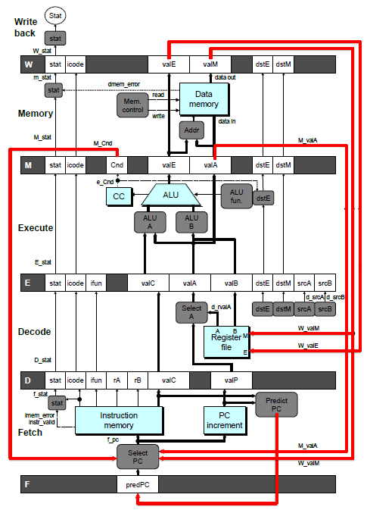
Feedback Paths
Important for distinguishing dependencies between pipeline stages
Predicted PC
  Guess value of next PC
Branch information
  Jump taken/not-taken
  Fall-through or target address
Return point
  Read from memory
Register updates
  To register file write ports

Slide 26
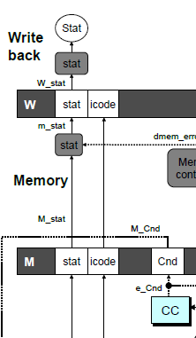
Signal Naming Conventions
S_Field
  Value of Field held in stage S pipeline register
s_Field
  Value of Field computed in stage S

Slide 27
Dealing with Dependencies between Instructions

Slide 28
Hazards
Hazards
  Problems caused by dependencies between separate instructions in the pipeline
Data Hazards
  Instruction having register R as source follows shortly after instruction having register R as destination
  Common condition, don’t want to slow down pipeline
Control Hazards
  Mispredict conditional branch
    Our design predicts all branches as being taken
    Naïve pipeline executes two extra instructions
  Getting return address for ret instruction
    Naïve pipeline executes three extra instructions

Slide 29
Dealing with Dependencies between Instructions
Data Hazards

Slide 30
Data Dependencies
- not a problem in SEQ
Combinational
logic
R
e
g
Clock
OP1
OP2
OP3
Time
System
  Each operation depends on result from preceding one

Slide 31
Data Hazards
- the problems caused by data dependences in pipelined datapaths
Comb.
logic
A
R
e
g
Comb.
logic
B
R
e
g
Comb.
logic
C
R
e
g
OP1
A
B
C
Clock
OP2
A
B
C
OP3
A
B
C
OP4
A
B
C
Time
  Result does not feed back around in time for next operation
  Pipelining has changed behavior of system

Slide 32
Data Dependencies between Instructions
1 irmovl $50, %eax
2 addl %eax , %ebx
3 mrmovl 100( %ebx ), %edx
  Result from one instruction used as operand for another
    Read-after-write (RAW) dependency
  Very common in actual programs
  Must make sure our pipeline handles these properly
    Get correct results
    Minimize performance impact

Slide 33
Data Dependencies – Loop-Carried Dependencies
mrmovl 4(%esp), %ecx
mrmovl 8(%esp), %edx
mrmovl 12(%esp),%ebx
LOOP: mrmovl 0(%ecx), %edi
mrmovl 0(%edx), %eax
%ecx
addl %eax, %edi
%edx
rmmovl %edi, 0(%edx)
%edx
%ecx
iaddl $4, %ecx
%edx
iaddl $4, %edx
%ebx
iaddl $-1, %ebx
jne LOOP

Slide 34
Pipeline Demonstration
1
2
3
4
5
6
7
8
9
irmovl $1,%eax #I1
F
D
E
M
W
irmovl $2,%ecx #I2
F
D
E
M
W
irmovl $3,%edx #I3
F
D
E
M
W
irmovl $4,%ebx #I4
F
D
E
M
W
halt #I5
F
D
E
M
W
Cycle 5
File: demo-basic.ys
W
I1
M
I2
All the instructions are independent
of each other
- No dependencies exist
E
I3
D
I4
F
I5

Slide 35
Data Dependencies: 3 Nop’s
# demo-h3.ys
1
2
3
4
5
6
7
8
9
10
11
F
F
D
D
E
E
M
M
W
0x000:
irmovl
$10,%
edx
W
F
F
D
D
E
E
M
M
W
0x006:
irmovl
$3,%
eax
W
F
F
D
D
E
E
M
M
W
0x00c:
nop
W
F
F
D
D
E
E
M
M
W
0x00d:
nop
W
F
F
D
D
E
E
M
M
W
0x00e:
nop
W
F
F
D
D
E
E
M
M
W
0x00f:
addl
%
edx
,%
eax
W
F
F
D
D
E
E
M
M
W
0x011: halt
W
The addl instruction depends on the first two instructions
addl depends upon %edx from the 1st instr
addl depends upon %eax from the 2nd instr
addl must wait 3 cycles after the 2nd instruction, so that it doesn’t fetch the two registers before they’ve been written to the register file
Cycle 6
W
W
f
R[
f
R[
]
]
3
%
3
%
eax
eax
Cycle 7
D
D
f
valA
f
valA
R[
R[
]
]
=
=
10
%
10
%
edx
edx
f
valB
f
valB
R[
R[
]
]
=
=
3
%
3
%
eax
eax

Slide 36
Data Dependencies: 2 Nop’s
# demo-h2.ys
1
2
3
4
5
6
7
8
9
10
F
F
D
D
E
E
M
M
W
0x000:
irmovl
$10,%
edx
W
F
F
D
D
E
E
M
M
W
0x006:
irmovl
$3,%
eax
W
F
F
D
D
E
E
M
M
W
0x00c:
nop
W
F
F
D
D
E
E
M
M
W
0x00d:
nop
W
F
F
D
D
E
E
M
M
W
0x00e:
addl
%
edx
,%
eax
W
F
F
D
D
E
E
M
M
W
0x010: halt
W
Cycle 6
W
W
W
f
f
R[
f
R[
R[
]
]
]
3
3
%
3
%
%
eax
eax
eax
If addl executes one cycle earlier, it gets the wrong value for %eax
•
•
•
•
•
•
D
D
D
f
f
valA
f
valA
valA
R[
R[
R[
]
]
]
=
=
=
10
10
%
10
Error
%
%
edx
edx
edx
f
f
valB
f
valB
valB
R[
R[
R[
]
]
]
=
=
=
0
0
%
0
%
%
eax
eax
eax

Slide 37
Data Dependencies: 1 Nop
# demo-h1.ys
1
2
3
4
5
6
7
8
9
0x000:
irmovl
$10,%
edx
F
D
E
M
W
0x006:
irmovl
$3,%
eax
F
D
E
M
W
F
F
D
D
E
E
M
M
W
0x00c:
nop
W
F
F
D
D
E
E
M
M
W
0x00d:
addl
%
edx
,%
eax
W
F
F
D
D
E
E
M
M
W
0x00f: halt
W
Cycle 5
W
W
f
R[
f
R[
]
]
10
%
10
%
edx
edx
If addl executes two cycles earlier, it gets the wrong value for both %eax and %ebx
M
M_
valE
= 3
M_
dstE
=
%
eax
•
•
•
D
D
Error
f
valA
f
valA
R[
R[
]
]
=
=
0
%
0
%
edx
edx
f
valB
f
valB
R[
R[
]
]
=
=
0
%
0
%
eax
eax

Slide 38
Data Dependencies: No Nop
# demo-h0.ys
1
2
3
4
5
6
7
8
0x000:
irmovl
$10,%
edx
F
D
E
M
W
0x006:
irmovl
$3,%
eax
F
D
E
M
W
0x00c:
addl
%
edx
,%
eax
F
D
E
M
W
0x00e: halt
F
D
E
M
W
Cycle 4
M
Like the prior case, if addl executes three cycles earlier, it gets the wrong value for both %eax and %ebx
M_
valE
= 10
M_
dstE
=
%
edx
E
e_
valE
f
0 + 3 = 3
E_
dstE
=
%
eax
D
D
Error
f
valA
f
valA
R[
R[
]
]
=
=
0
%
0
%
edx
edx
f
valB
f
valB
R[
R[
]
]
=
=
0
%
0
%
eax
eax

Slide 39
Stalling for Data Dependencies
# demo-h2.ys
1
2
3
4
5
6
7
8
9
10
11
0x000: irmovl $10,%edx
F
D
E
M
W
0x006: irmovl $3,%eax
F
D
E
M
W
0x00c: nop
F
D
E
M
W
0x00d: nop
F
D
E
M
W
bubble
E
M
W
0x00e: addl %edx,%eax
F
D
D
E
M
W
0x010: halt
F
F
D
E
M
W
  If instruction follows too closely after one that writes register, slow it down
  Hold instruction in decode
  Dynamically inject nop into execute stage

Slide 40
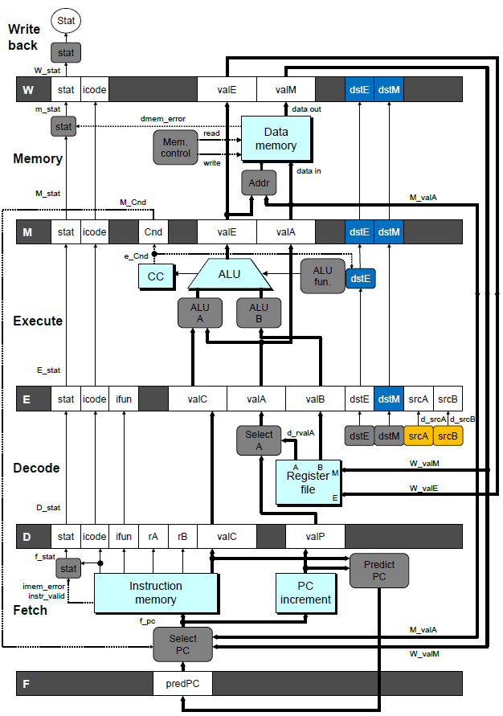
Stall Condition
Source Registers
  srcA and srcB of current instruction in decode stage
Destination Registers
  dstE and dstM fields
  Instructions in execute, memory, and write-back stages
Special Case
  Don’t stall for register ID 15 (0xF)
    Indicates absence of register operand
  Don’t stall for failed conditional move

Slide 41
Detecting Stall Condition
# demo-h2.ys
1
2
3
4
5
6
7
8
9
10
11
0x000: irmovl $10,%edx
F
D
E
M
W
0x006: irmovl $3,%eax
F
D
E
M
W
0x00c: nop
F
D
E
M
W
0x00d: nop
F
D
E
M
W
bubble
E
M
W
0x00e: addl %edx,%eax
F
D
D
E
M
W
0x010: halt
F
F
D
E
M
W
Cycle 6
W
W_dstE = %eax
W_valE = 3
•
•
•
D
srcA = %edx
srcB = %eax

Slide 42
Stalling X3
# demo-h0.ys
1
2
3
4
5
6
7
8
9
10
11
0x000: irmovl $10,%edx
F
D
E
M
W
0x006: irmovl $3,%eax
F
D
E
M
W
bubble
E
M
W
bubble
E
M
W
bubble
E
M
W
0x00c: addl %edx,%eax
F
D
D
D
D
E
M
W
0x00e: halt
F
F
F
F
D
E
M
W
Cycle 6
W
Cycle 5
W_dstE = %eax
M
Cycle 4
M_dstE = %eax
•
•
•
E
•
•
•
E_dstE = %eax
D
D
D
srcA = %edx
srcB = %eax
srcA = %edx
srcB = %eax
srcA = %edx
srcB = %eax

Slide 43
What Happens When Stalling?
# demo-h0.ys
Cycle 4
Cycle 5
Cycle 6
Cycle 7
Cycle 8
0x000: irmovl $10,%edx
Write Back
0x000: irmovl $10,%edx
0x006: irmovl $3,%eax
bubble
bubble
0x006: irmovl $3,%eax
Memory
0x000: irmovl $10,%edx
0x006: irmovl $3,%eax
bubble
bubble
bubble
0x00c: addl %edx,%eax
Execute
0x006: irmovl $3,%eax
bubble
bubble
bubble
0x00c: addl %edx,%eax
0x00e: halt
Decode
0x00c: addl %edx,%eax
0x00c: addl %edx,%eax
0x00c: addl %edx,%eax
0x00c: addl %edx,%eax
0x00e: halt
Fetch
0x00e: halt
0x00e: halt
0x00e: halt
0x00e: halt
  Stalling instruction held back in decode stage
  Following instruction stays in fetch stage
  Bubbles injected into execute stage
    Like dynamically generated nop’s
    Move through later stages

Slide 44
Pipeline Register Modes
Rising
Rising
Input = y
Output = x
_
clock
_
Output = y
clock
Normal
x
x
y
y
stall
bubble
= 0
= 0
Rising
Rising
Input = y
Output = x
_
clock
_
Output = x
clock
Stall
x
x
x
x
stall
bubble
= 1
= 0
Rising
Rising
Input = y
Output = x
_
clock
_
Output =
nop
clock
n
Bubble
x
x
o
p
stall
bubble
= 0
= 1

Slide 45
Implementing Stalling
Pipe
control
logic
W_stat
W
W_stall
stat
icode
valE
valM
dstE
dstM
M_icode
M_bubble
M
stat
icode
Cnd
valE
valA
dstE
dstM
m_stat
e_Cnd
stat
set_cc
CC
E_dstM
E_icode
E_bubble
E
stat
icode
ifun
valC
valA
valB
dstE
dstM
srcA
srcB
d_srcB
d_srcA
srcB
D_icode
srcA
D_bubble
D
D_stall
stat
icode
ifun
rA
rB
valC
valP
F_stall
F
predPC
Pipeline Control
  Combinational logic detects stall condition
  Sets mode signals for how pipeline registers should update

Slide 46
Data Forwarding
Naïve Pipeline
  Register isn’t written until completion of write-back stage
  Source operands read from register file in decode stage
    Needs to be in register file at start of stage
Observation
  Value generated in execute or memory stage
Trick
  Pass value directly from generating instruction to decode stage
  Needs to be available at end of decode stage

Slide 47
Data Forwarding Example
# demo-h2.ys
1
2
3
4
5
6
7
8
9
10
F
F
D
D
E
E
M
M
W
0x000:
irmovl
$10,%
edx
W
F
F
D
D
E
E
M
M
W
0x006:
irmovl
$3,%
eax
W
F
F
D
D
E
E
M
M
W
0x00c:
nop
W
F
F
D
D
E
E
M
M
W
0x00d:
nop
W
F
F
D
D
E
E
M
M
W
0x00e:
addl
%
edx
,%
eax
W
F
F
D
D
E
E
M
M
W
0x010: halt
W
  irmovl in write-back stage
  Destination value in W pipeline register
  Forward as valB for decode stage
Cycle 6
W
W_
dstE
=
%
eax
R[
%
eax
]
f
3
W_
valE
= 3
•
•
•
D
srcA
=
%
edx
valA
f
R[
%
edx
]
=
10
srcB
=
%
eax
valB
f
W_
valE
=
3

Slide 48
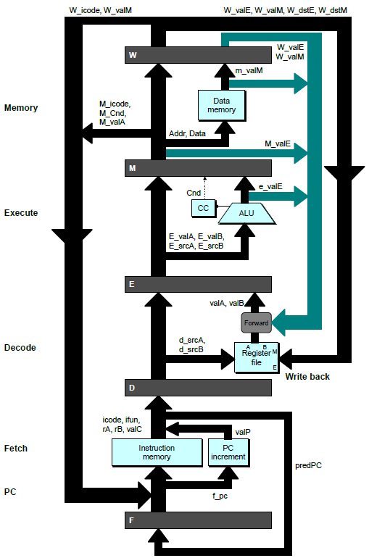
Bypass Paths
Decode Stage
  Forwarding logic selects valA and valB
  Normally from register file
  Forwarding: get valA or valB from later pipeline stage
Forwarding Sources
  Execute: valE
  Memory: valE, valM
  Write back: valE, valM

Slide 49
Data Forwarding Example #2
Register %edx
  Generated by ALU during previous cycle
  Forward from memory as valA
Register %eax
  Value just generated by ALU
  Forward from execute as valB

Slide 50
Forwarding Priority
# demo-priority.ys
1
2
3
4
5
6
7
8
9
10
F
F
D
D
E
E
M
M
W
0x000: irmovl $1, %eax
W
F
F
D
D
E
E
M
M
W
0x006: irmovl $2, %eax
W
F
F
D
D
E
E
M
M
W
0x00c: irmovl $3, %eax
W
F
F
D
D
E
E
M
M
W
0x012: rrmovl %eax, %edx
W
F
F
D
D
E
E
M
M
W
0x014: halt
W
Multiple Forwarding Choices
  Which one should have priority
  Match serial semantics
  Use matching value from earliest pipeline stage
Cycle 5
W
W
f
R[
f
R[
]
]
3
%
1
%
eax
eax
W
M
f
R[
f
R[
]
]
3
%
2
%
eax
eax
W
E
f
R[
f
R[
]
]
3
%
3
%
eax
eax
D
D
D
f
f
valA
f
valA
valA
R[
R[
R[
]
]
]
=
=
=
10
10
%
?
%
%
edx
edx
eax
f
f
valB
f
valB
valB
R[
R[
0
%
eax
]
=
0

Slide 51
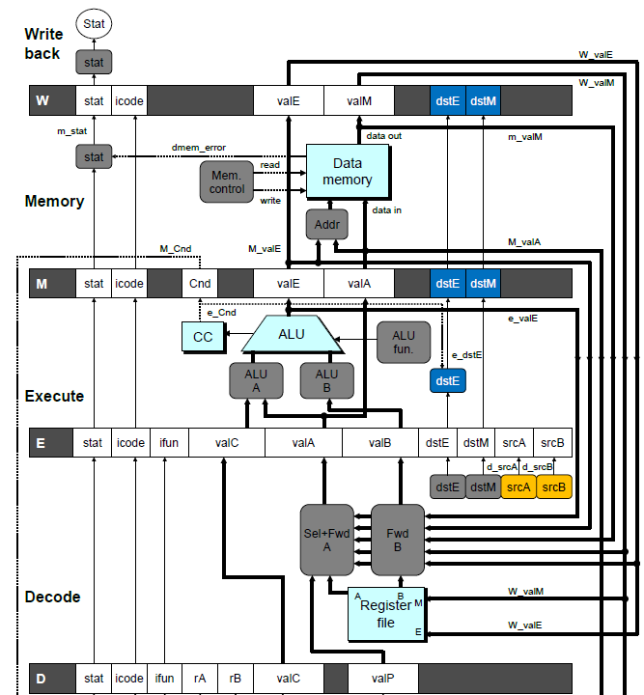
Implementing Forwarding
  Add additional feedback paths from E, M, and W pipeline registers into decode stage
  Create logic blocks to select from multiple sources for valA and valB in decode stage

Slide 52
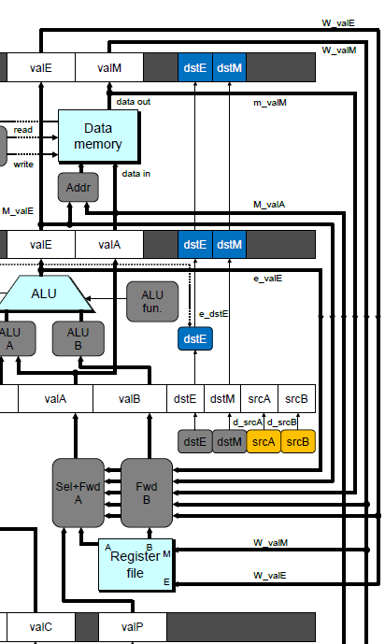
Implementing Forwarding
## What should be the A value?
int new_E_valA = [
# Use incremented PC
D_icode in { ICALL, IJXX } : D_valP;
# Forward valE from execute
d_srcA == e_dstE : e_valE;
# Forward valM from memory
d_srcA == M_dstM : m_valM;
# Forward valE from memory
d_srcA == M_dstE : M_valE;
# Forward valM from write back d_srcA == W_dstM : W_valM;
# Forward valE from write back
d_srcA == W_dstE : W_valE;
# Use value read from register file
1 : d_rvalA;
];

Slide 53
Limitation of Forwarding
Load-use dependency
  Value needed by end of decode stage in cycle 7
  Value read from memory in memory stage of cycle 8

Slide 54
Avoiding Load/Use Hazard
  Stall using instruction for one cycle
  Can then pick up loaded value by forwarding from memory stage

Slide 55
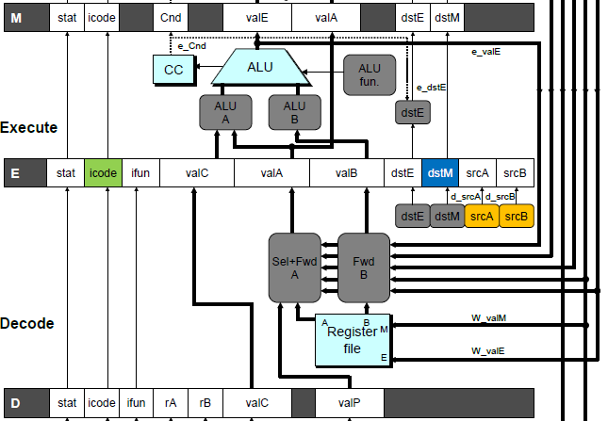
Detecting Load/Use Hazard
Condition | Trigger
Load/Use Hazard | E_icode in { IMRMOVL, IPOPL } && E_dstM in { d_srcA, d_srcB }

Slide 56
Control for Load/Use Hazard
# demo
-
luh
.
ys
1
2
3
4
5
6
7
8
9
10
11
12
F
F
D
D
E
E
M
M
W
0x000:
irmovl
$128,%
edx
W
F
F
D
D
E
E
M
M
W
0x006:
irmovl
$3,%
ecx
W
F
F
D
D
E
E
M
M
W
0x00c:
rmmovl
%
ecx
, 0(%
edx
)
W
F
F
D
D
E
E
M
M
W
0x012:
irmovl
$10,%
ebx
W
%
eax
# Load %
eax
F
F
F
D
D
D
E
E
E
M
M
M
W
W
0x018:
mrmovl
0(%
edx
),
W
bubble
E
M
W
0x01e:
addl
%
ebx
,
%
eax
# Use %
eax
F
D
D
E
M
W
0x020: halt
F
F
D
E
M
W
  Stall instructions in fetch and decode stages
  Inject bubble into execute stage
Condition | F | D | E | M | W
Load/Use Hazard | stall | stall | bubble | normal | normal

Slide 57
Dealing with Dependencies between Instructions
Control Hazards

Slide 58
Branch Misprediction Example
demo-j.ys
0x000: xorl %eax,%eax
0x002: jne t # Not taken
0x007: irmovl $1, %eax # Fall through
0x00d: nop
0x00e: nop
0x00f: nop
0x010: halt
0x011: t: irmovl $3, %edx # Target (Should not execute)
0x017: irmovl $4, %ecx # Should not execute
0x01d: irmovl $5, %edx # Should not execute
  Should only execute first 8 instructions

Slide 59
Branch Misprediction Trace
# demo
-
j
1
2
3
4
5
6
7
8
9
0x000:
xorl
F
D
E
M
W
%
eax
,%
eax
0x002:
jne
t # Not taken
F
D
E
M
W
0x011: t:
irmovl
$3, %
edx
# Target
F
D
E
M
W
0x017:
irmovl
$4, %
ecx
# Target+1
F
D
E
M
W
F
F
D
D
E
E
M
M
W
0x007:
irmovl
$1, %
eax
# Fall Through
W
Cycle 5
  Incorrectly execute two instructions at branch target
M
M_Cnd =
0
M_
valA
= 0x007
E
E
f
valE
f
valE
3
3
dstE
dstE
=
=
%
%
edx
edx
D
D
valC
valC
=
=
4
4
dstE
dstE
=
=
%
%
ecx
ecx
F
F
f
valC
f
valC
1
1
f
rB
f
rB
%
%
eax
eax

Slide 60
Handling Misprediction
Predict branch as taken
  Fetch 2 instructions at target
Cancel when mispredicted
  Detect branch not-taken in execute stage
  On following cycle, replace instructions in execute and decode by bubbles
  No side effects have occurred yet

Slide 61
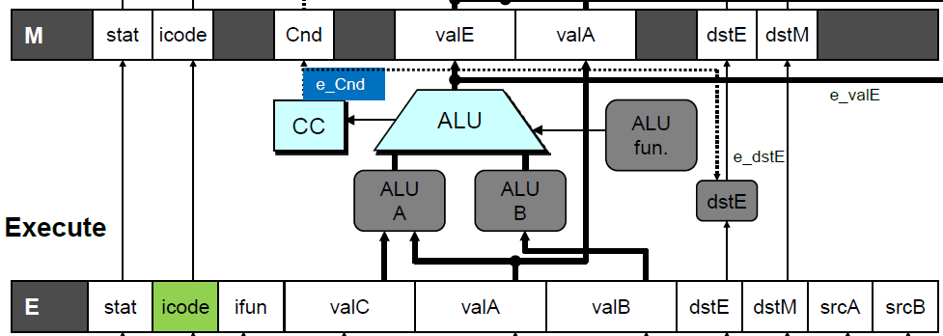
Detecting Mispredicted Branch
Condition | Trigger
Mispredicted Branch | E_icode = IJXX & !e_Cnd

Slide 62
Control for Misprediction
Condition | F | D | E | M | W
Mispredicted Branch | normal | bubble | bubble | normal | normal

Slide 63
Return Example
demo-retb.ys
0x000: irmovl Stack,%esp # Initialize stack pointer
0x006: call p # Procedure call
0x00b: irmovl $5,%esi # Return point
0x011: halt
0x020: .pos 0x20
0x020: p: irmovl $-1,%edi # procedure
0x026: ret
0x027: irmovl $1,%eax # Should not be executed
0x02d: irmovl $2,%ecx # Should not be executed
0x033: irmovl $3,%edx # Should not be executed
0x039: irmovl $4,%ebx # Should not be executed
0x100: .pos 0x100
0x100: Stack: # Stack: Stack pointer
  Previously executed three additional instructions

Slide 64
Incorrect Return Example
  Incorrectly execute 3 instructions following ret

Slide 65
Correct Return Example
# demo
-
retb
0x026: ret
F
D
E
M
W
bubble
F
D
E
M
W
bubble
F
D
E
M
W
bubble
F
D
E
M
W
F
F
D
D
E
E
M
M
W
0x00b:
irmovl
$5,%
esi
# Return
W
  As ret passes through pipeline, stall at fetch stage
    While in decode, execute, and memory stage
  Inject bubble into decode stage
  Release stall when reach write-back stage
W
W
valM
valM
=
=
0x0b
0x0b
•
•
•
F
F
f
valC
f
valC
5
5
f
rB
f
rB
%
%
esi
esi

Slide 66
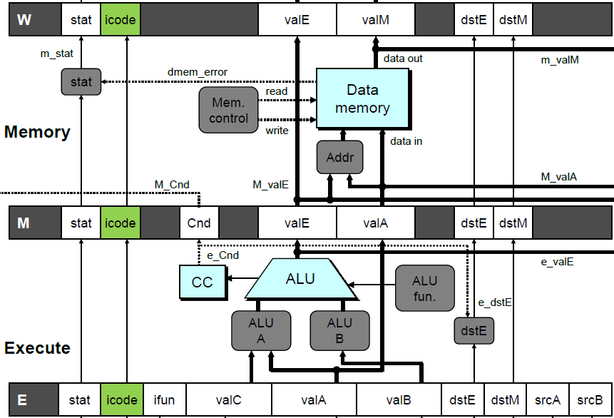
Detecting Return
Condition | Trigger
Processing ret | IRET in { D_icode, E_icode, M_icode }

Slide 67
Control for Return
# demo
-
retb
0x026: ret
F
D
E
M
W
bubble
F
D
E
M
W
bubble
F
D
E
M
W
bubble
F
D
E
M
W
F
F
D
D
E
E
M
M
W
0x00b:
irmovl
$5,%
esi
# Return
W
Condition | F | D | E | M | W
Processing ret | stall | bubble | normal | normal | normal

Slide 68
Special Control Cases
Detection
Action (on next cycle)
Condition | Trigger
Processing ret | IRET in { D_icode, E_icode, M_icode }
Load/Use Hazard | E_icode in { IMRMOVL, IPOPL } && E_dstM in { d_srcA, d_srcB }
Mispredicted Branch | E_icode = IJXX & !e_Cnd
Condition | F | D | E | M | W
Processing ret | stall | bubble | normal | normal | normal
Load/Use Hazard | stall | stall | bubble | normal | normal
Mispredicted Branch | normal | bubble | bubble | normal | normal

Slide 69
Implementing Pipeline Control
Pipe
control
logic
W_stat
W
W_stall
stat
icode
valE
valM
dstE
dstM
M_icode
M_bubble
M
stat
icode
Cnd
valE
valA
dstE
dstM
m_stat
e_Cnd
stat
set_cc
CC
E_dstM
E_icode
E_bubble
E
stat
icode
ifun
valC
valA
valB
dstE
dstM
srcA
srcB
d_srcB
d_srcA
srcB
D_icode
srcA
D_bubble
D
D_stall
stat
icode
ifun
rA
rB
valC
valP
F_stall
F
predPC
  Combinational logic generates pipeline control signals
  Action occurs at start of following cycle

Slide 70
Initial Version of Pipeline Control
bool F_stall =
# Conditions for a load/use hazard
E_icode in { IMRMOVL, IPOPL } && E_dstM in { d_srcA, d_srcB } ||
# Stalling at fetch while ret passes through pipeline
IRET in { D_icode, E_icode, M_icode };
bool D_stall =
# Conditions for a load/use hazard
E_icode in { IMRMOVL, IPOPL } && E_dstM in { d_srcA, d_srcB };
bool D_bubble =
# Mispredicted branch
(E_icode == IJXX && !e_Cnd) ||
# Stalling at fetch while ret passes through pipeline
IRET in { D_icode, E_icode, M_icode };
bool E_bubble =
# Mispredicted branch
(E_icode == IJXX && !e_Cnd) ||
# Load/use hazard
E_icode in { IMRMOVL, IPOPL } && E_dstM in { d_srcA, d_srcB };

Slide 71
Control Combinations
  Special cases that can arise on same clock cycle
Combination A
  Not-taken branch
  ret instruction at branch target
Combination B
  Instruction that reads from memory to %esp
  Followed by ret instruction

Slide 72
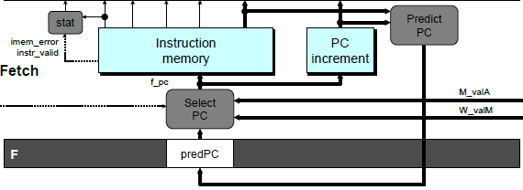
Control Combination A
1
1
Mispredict
1
Mispredict
ret
ret
ret
M
M
M
M
M
JXX
E
JXX
E
E
E
E
ret
ret
D
ret
D
D
D
D
Combination A
Condition | F | D | E | M | W
Processing ret | stall | bubble | normal | normal | normal
Mispredicted Branch | normal | bubble | bubble | normal | normal
Combination | stall | bubble | bubble | normal | normal
  Should handle as mispredicted branch
  Stalls F pipeline register
  But PC selection logic will be using M_valM anyhow

Slide 73
Control Combination B
1
1
Load/use
ret
1
ret
ret
M
M
M
M
E
Load
E
E
E
Use
ret
ret
D
D
ret
D
D
Combination B
Condition | F | D | E | M | W
Processing ret | stall | bubble | normal | normal | normal
Load/Use Hazard | stall | stall | bubble | normal | normal
Combination | stall | bubble + stall | bubble | normal | normal
  Would attempt to bubble and stall pipeline register D
  Signaled by processor as pipeline error

Slide 74
Handling Control Combination B
1
1
Load/use
ret
1
ret
ret
M
M
M
M
E
Load
E
E
E
Use
ret
ret
D
D
ret
D
D
Combination B
Condition | F | D | E | M | W
Processing ret | stall | bubble | normal | normal | normal
Load/Use Hazard | stall | stall | bubble | normal | normal
Combination | stall | stall | bubble | normal | normal
  Load/use hazard should get priority
  ret instruction should be held in decode stage for additional cycle

Slide 75
Corrected Pipeline Control Logic
bool D_bubble =
# Mispredicted branch
(E_icode == IJXX && !e_Cnd) ||
# Stalling at fetch while ret passes through pipeline
IRET in { D_icode, E_icode, M_icode }
# but not condition for a load/use hazard
&& !(E_icode in { IMRMOVL, IPOPL }
&& E_dstM in { d_srcA, d_srcB });
Condition | F | D | E | M | W
Processing ret | stall | bubble | normal | normal | normal
Load/Use Hazard | stall | stall | bubble | normal | normal
Combination | stall | stall | bubble | normal | normal
  Load/use hazard should get priority
  ret instruction should be held in decode stage for additional cycle

Slide 76
Pipeline Control Logic
  A sequence of control instructions complicates the control logic
    in particular, should stall in Decode stage (instead of bubble, as an initial inspection suggests)
  Load/use hazard should get priority
  ret instruction should be held in decode stage for additional cycle
Condition | F | D | E | M | W
Processing ret | stall | bubble | normal | normal | normal
Load/Use Hazard | stall | stall | bubble | normal | normal
Combination | stall | stall | bubble | normal | normal

Slide 77
Pipeline Summary
Concept
  Break instruction execution into 5 stages
  Run instructions through in pipelined mode
Limitations
  Can’t handle dependencies between instructions when instructions follow too closely
  Data dependencies
    One instruction writes register, later one reads it
  Control dependency
    Instruction sets PC in way that pipeline did not predict correctly
    Mispredicted branch and return

Slide 78
Pipeline Summary
Data Hazards
  Most handled by forwarding
    No performance penalty
  Load/use hazard requires one cycle stall
Control Hazards
  Cancel instructions when detect mispredicted branch
    Two clock cycles wasted
  Stall fetch stage while ret passes through pipeline
    Three clock cycles wasted
Control Combinations
  Must analyze carefully
  First version had subtle bug
    Only arises with unusual instruction combination

