Slide 1
Data Representation – Floating Point CSCI 224 / ECE 317: Computer Architecture
Instructor:
Prof. Jason Fritts
Slides adapted from Bryant & O’Hallaron’s slides

Slide 2
Today: Floating Point
Background: Fractional binary numbers
Example and properties
IEEE floating point standard: Definition
Floating point in C
Summary

Slide 3
Fractional binary numbers
What is 1011.101₂?

Slide 4
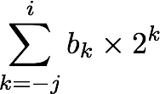
Fractional Binary Numbers
2^{i}
2^{i-1}
2² = 4
2¹ = 2
2⁰ = 1
• • •
bi | bi-1 | ••• | b2 | b1 | b0 | b-1 | b-2 | b-3 | ••• | b-j
2⁻¹ = 1/2
2⁻² = 1/4
2⁻³ = 1/8
2^{-j}
• • •
Representation
Bits to right of “binary point” represent fractional powers of 2
Represents rational number:
Notes:
Latex source for equation: \sum_{k=-j}^i b_k \times 2^k

Slide 5
Fractional Binary Numbers: Examples
Value Representation
$53/4$ 101.112 $=4+1+1/2+1/4=53/4$
$27/8$ 010.1112 $=2+1/2+1/4+1/8=27/8$
${25}/{64}$ 000.0110012 $=1/4+1/8+1/{64}={25}/{64}$
Observations
Divide by 2 by shifting right
Multiply by 2 by shifting left
Limitations
Can only exactly represent numbers of the form x/2^{k}
Other rational numbers have repeating bit representations
Value Representation
1/3 0.0101010101[01]…₂
1/5 0.001100110011[0011]…₂

Slide 6
Today: Floating Point
Background: Fractional binary numbers
Example and properties
IEEE floating point standard: Definition
Floating point in C
Summary

Slide 7
Tiny Floating Point Example
s | exp | frac
1 | 4-bits | 3-bits
8-bit Floating Point Representation
the sign bit is in the most significant bit
the next four bits are the exponent (exp), with a bias of 2⁴⁻¹ - 1 = 7
the last three bits are the fraction (frac)
Exponent bias
enable exponent to represent both positive and negative powers of 2
use half of range for positive and half for negative power
given k exponent bits, bias is then 2^{k-1} - 1

Slide 8
Floating Point Encodings and Visualization
Five encodings:
Two general forms: normalized, denormalized
Three special values: zero, infinity, NaN (not a number)
Name Exponent(exp) Fraction(frac)
zero exp == 0000 frac == 000
denormalized exp == 0000 frac != 000
normalized 0000 < exp < 1111 frac != 000
infinity exp == 1111 frac == 000
NaN exp == 1111 frac != 000
−∞
+∞
−Normalized
−Denorm
+Denorm
+Normalized
NaN
NaN
−0
+0

Slide 9
Dynamic Range (Positive Only)
s exp frac E Value
0 0000 000 -6 0
0 0000 001 -6 1/8*1/64 = 1/512
0 0000 010 -6 2/8*1/64 = 2/512
…
0 0000 110 -6 6/8*1/64 = 6/512
0 0000 111 -6 7/8*1/64 = 7/512
0 0001 000 -6 8/8*1/64 = 8/512
0 0001 001 -6 9/8*1/64 = 9/512
…
0 0110 110 -1 14/8*1/2 = 14/16
0 0110 111 -1 15/8*1/2 = 15/16
0 0111 000 0 8/8*1 = 1
0 0111 001 0 9/8*1 = 9/8
0 0111 010 0 10/8*1 = 10/8
…
0 1110 110 7 14/8*128 = 224
0 1110 111 7 15/8*128 = 240
0 1111 000 n/a inf
0 1111 xxx n/a NaN
zero
closest to zero
Denormalized
numbers
largest denorm
smallest norm
closest to 1 below
Normalized
numbers
closest to 1 above
largest norm
infinity
NaN (not a number)

Slide 10
Distribution of Values
(reduced format from 8 bits
to 6 bits for visualization)
6-bit IEEE-like format
e = 3 exponent bits
f = 2 fraction bits
Bias is 2³⁻¹-1 = 3
Notice how the distribution gets denser toward zero.
s | exp | frac
1 | 3-bits | 2-bits
8 denormalized values
(blowup of -1 → 1)

Slide 11
Today: Floating Point
Background: Fractional binary numbers
IEEE floating point standard: Definition
Example and properties
Floating point in C
Summary

Slide 12
IEEE Floating Point
IEEE Standard 754
Established in 1985 as uniform standard for floating point arithmetic
Before that, many idiosyncratic formats
Supported by all major CPUs
Driven by numerical concerns
Nice standards for rounding, overflow, underflow
Hard to make fast in hardware
Numerical analysts predominated over hardware designers in defining standard

Slide 13
Floating Point Representation
Numerical Form: (–1)^{s} M 2E
Sign bit s determines whether number is negative or positive
Significand M normally a fractional value in range [1.0, 2.0)
Exponent E weights value by power of two
Encoding
MSB s is sign bit s
exp field encodes E (but is not equal to E)
frac field encodes M (but is not equal to M)
s | exp | frac

Slide 14
Precisions
Single precision: 32 bits
Double precision: 64 bits
Extended precision: 80 bits (Intel only)
s | exp | frac
1 | 8-bits | 23-bits
s | exp | frac
1 | 11-bits | 52-bits
s | exp | frac
1 | 15-bits | 63 or 64-bits

Slide 15
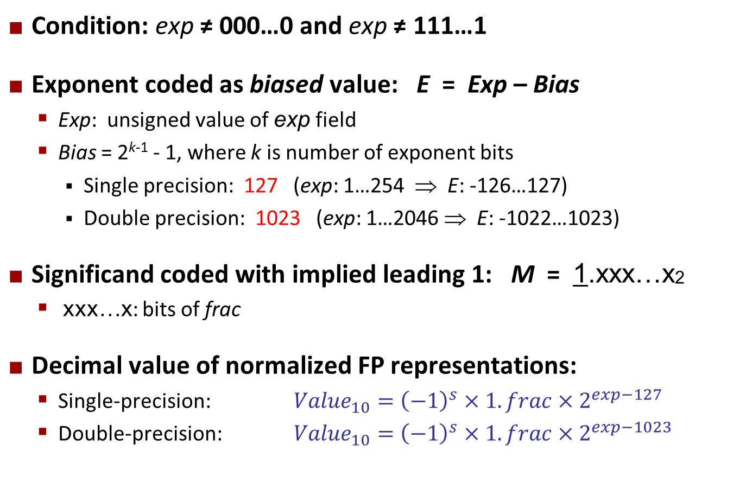
Normalized Values
Condition: exp ≠ 000…0 and exp ≠ 111…1
Exponent coded as biased value: E = Exp – Bias
Exp: unsigned value of exp field
Bias = 2^{k-1} - 1, where k is number of exponent bits
Single precision: 127 (exp: 1…254 ⇒ E: -126…127)
Double precision: 1023 (exp: 1…2046 ⇒ E: -1022…1023)
Significand coded with implied leading 1: M = 1.xxx…x2
xxx…x: bits of frac
Decimal value of normalized FP representations:
Single-precision: ${Value}_{10}={\left(−1\right)}^{s}×1.frac×2^{exp−127}$
Double-precision: ${Value}_{10}={\left(−1\right)}^{s}×1.frac×2^{exp−1023}$

Slide 16
Normalized Encoding Example
shift binary point by K bits so that
only one leading 1 bit remains on
the left side of the binary point
(here, shifted right by 13 bits, so K = 13),
then multiply by 2^{K} (here, 2¹³)
Value: float F = 15213.0;
15213₁₀ = 11101101101101₂
= 1.1101101101101₂ x 2¹³
Significand
M = 1.1101101101101₂
frac = 11011011011010000000000₂
Exponent (E = Exp – Bias)
E = 13
Bias = 127
Exp = E + Bias = 140 = 10001100₂
0 10001100 11011011011010000000000
s
exp
frac

Slide 17
Denormalized Values
Condition: exp = 000…0
Exponent value: E = –Bias + 1 (instead of E = 0 – Bias)
Significand coded with implied leading 0: M = 0.xxx…x2
xxx…x: bits of frac
Cases
exp = 000…0, frac = 000…0
Represents zero value
Note distinct values: +0 and –0 (why?)
exp = 000…0, frac ≠ 000…0
Numbers very close to 0.0
Lose precision as get smaller
Equispaced

Slide 18
Special Values
Condition: exp = 111…1
Case: exp = 111…1, frac = 000…0
Represents value ∞ (infinity)
Operation that overflows
Both positive and negative
E.g., 1.0/0.0 = −1.0/−0.0 = +∞, 1.0/−0.0 = −∞
Case: exp = 111…1, frac ≠ 000…0
Not-a-Number (NaN)
Represents case when no numeric value can be determined
E.g., sqrt(–1), ∞ − ∞, ∞ × 0

Slide 19
Interesting Numbers
{single,double}
Description exp frac Numeric Value
Zero 00…00 00…00 0.0
Smallest Pos. Denorm. 00…00 00…01 2^{– {23,52}} x 2^{– {126,1022}}
Single ≈ 1.4 x 10^{–45}
Double ≈ 4.9 x 10^{–324}
Largest Denormalized 00…00 11…11 (1.0 – ε) x 2^{– {126,1022}}
Single ≈ 1.18 x 10^{–38}
Double ≈ 2.2 x 10^{–308}
Smallest Pos. Normalized 00…01 00…00 1.0 x 2^{– {126,1022}}
Just larger than largest denormalized
One 01…11 00…00 1.0
Largest Normalized 11…10 11…11 (2.0 – ε) x 2^{{127,1023}}
Single ≈ 3.4 x 10³⁸
Double ≈ 1.8 x 10³⁰⁸

Slide 20
Today: Floating Point
Background: Fractional binary numbers
Example and properties
IEEE floating point standard: Definition
Floating point in C
Summary

Slide 21
Floating Point in C
C Guarantees Two Levels
float single precision
double double precision
Conversions/Casting
Casting between int, float, and double changes bit representation
double/float → int
Truncates fractional part
Like rounding toward zero
Not defined when out of range or NaN: Generally sets to TMin
int → double
Exact conversion, as long as int has ≤ 53 bit word size
int → float
Will round according to rounding mode

Slide 22
Today: Floating Point
Background: Fractional binary numbers
Example and properties
IEEE floating point standard: Definition
Floating point in C
Summary

Slide 23
Summary
Represents numbers of form M x 2E
One can reason about operations independent of implementation
As if computed with perfect precision and then rounded
Not the same as real arithmetic
Violates associativity/distributivity
Makes life difficult for compilers & serious numerical applications programmers

